Slide 1
Deriving User Experience Model

Slide 2
Contents
Introduction
Design Strategy
Creating a design Strategy
Uncovering the User’s Conceptual Model
Profiles and Personas
Field Studies
Deriving the User Experience Model
Scenario and task analysis
Primary noun architecture
Information architecture
Getting ready for Detailed Design

Slide 3
Introduction

Slide 4
Elements of User Centered Design
Active involvement of users
Clear understanding of user requirements, tasks and environments
Allocation of function between users and technology
Validation Testing with users

Slide 5
What is User-Centered analysis?
Process of discovering…
Who the users are
How they think and work
The stakeholder goals and objectives
Collecting data on
User profiles
Work environment
Scenarios of how users will use the interface
Task analysis
The goal of user – centered analysis is to collect and
analyze data to make informed interface design decisions

Slide 6
Objectives of UCD
Improving usability and UX is about measuring
and improving
Effectiveness – Can users achieve what they need by using the product?
Ease of learning – How fast can users who have never seen the interface learn to use it?
Efficiency of use – How fast can users complete tasks?
Memorability – Can users remember enough to reuse the interface effectively?
Error prevention – Can users complete tasks without making errors?
Satisfaction – How much do users like using the system?

Slide 7
Match the users mental model to the interface conceptual model
Users mental model guides all of their behavior
80% of the usability derives from matching the conceptual model
Usability analysts must diagnose and document the users conceptual model

Slide 8
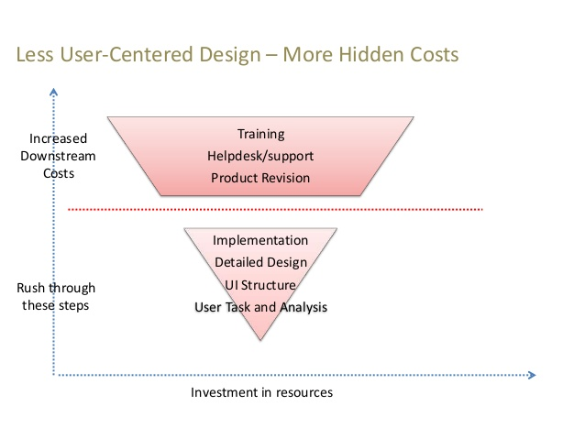
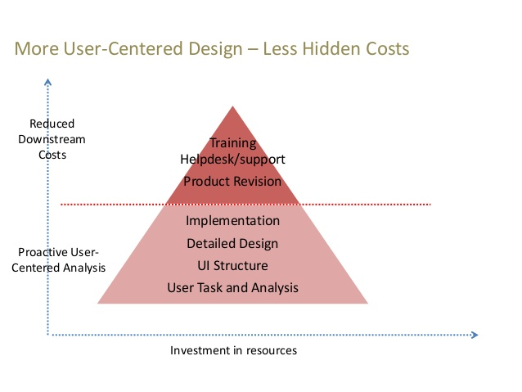

Slide 9
Design Strategy

Slide 10
Creating a design strategy
Components of design strategy
Business goals
Target users
General tasks (“Use the design to…”)
Technological constraints
Marketing/ Branding goals
Critical success factors

Slide 11
Example: E-commerce site
Business Goals
Increase sales
Increase repeat business
Target users
Home office users
Small businesses
General Tasks
Learn, Find, Select, Buy
Technological Constraints
Multiple browsers on desktop/laptop machines
Marketing/ Branding Goals
Economical, High-Quality, Consumer oriented
Critical Success factors
80% of site visitors who add their product to their cart complete checkout
60% of buyers buy accessories

Slide 12
Uncovering the users conceptual model

Slide 13
Value of Profiles and Personas
Describes the Design Strategy with who is doing what and where
Clarify assumptions about users and their tasks, including task environment
Communicate those assumptions
Highlight aspects of user group that influence your design
Highlight variation among user groups
Provide a basis for prioritizing user groups
Provide a means to document rationale for early design decisions

Slide 14
Profiles
User Profile
Task Profile
Environmental profile

Slide 15
User Profiles
Characteristic | Variable | Design Implications
Health/age/gender | Visual acuity Motor skills | Font size Color/contrast
Education | Reading Level General Knowledge | Documentation/training/help
Computer experience | How much What kind | Modality Wizards/tutorials/tooltips
Domain expertise | How much | Documentation/training/help
Characteristic | Customer Service representative | Customer
Age/ Gender | 75% Female, Median Age 32 | 75% male, Age 25 to 40, Media 30
Education | Some higher education | Most have degrees
Computer Experience | Low to med | Med
Domain Expertise | Low to High | Medium

Slide 16
Task Profiles
Tasks | Roles
 | Customer Service Representative | Outside Sales | Customer | Administrator
Request new user name & password |  |  | Yes
Find customer (search, browse) | Yes | Yes | Yes
View Customer | Yes | Yes
Edit/Enter customer data | Yes |  | Yes
View buying history | Yes |  | Yes
View reports |  | Yes |  | Yes

Slide 17
Environmental Profile
 | Customer Service Rep | Customer
Location | Indoor | Indoor and mobile
Lighting | Good | Average to low
Workspace | Cubicle | Home office or mobile use
Browser | Firefox | IE, Firefox, Chrome or Safari

Slide 18
Personas
A persona is a concrete “characterization” of a single group
Synthesis of information from the profiles
User
Tasks
Environmental
Create personas for each target group (Current users, missing users, high – value customers, frequent users, etc.)
While creating personas, focus on probabilities and not possibilities
Personas help in distinguishing developer desire and user needs
Personas facilitates communication with design and implementation teams.

Slide 19

Sample Persona
Jim Duncan, Software engineer
29 years old
Single
5 years with a company
Has a degree in engineering
Loves sports of all kinds
Known as a go to person
Travels frequently for work
Things he wants to know
Things he wants to do
Information about previous trips
Available travel options
Travel costs
Frequent flyer information
Hotel rewards program information
Book travel for himself
Be able to have a travel agent book travel for him
Update and change travel arrangements
Book air, hotel and car rental in a single transaction

Slide 20
Field Studies
Direct Interview
User observations
Notes:
We will be briefly discussing the above points field studies

Slide 21
Direct Interview
Designing interview questions
Focus on how
How users think about the topic and purpose of the application
Word the question so it makes sense to users
Seeking insight, not statistical significance
Want insight into how users are thinking, not a study of what they want
Ask diagnostic questions
Allows interviewer to figure out users assumptions
Does not rely on user to report their assumptions
Ask performance related questions to generate more accurate data

Slide 22
Things to know about the user | Questions to ask the user
Motivation | How important is this application and why do you need it
Domain Knowledge | How much do you know about (domain name)
Task Flows | What are the most important and frequent tasks you need to perform in this application? How do you go about completing these tasks? Do you consider this to be a difficult task? Do you think a new user would have trouble learning this task?
Problems and opportunities | Have you used any application to do these tasks before? When was the last time you used this application? What did you like or dislike about the application?
Usage pattern | How much time do you spend in a week using this application?
Additional Needs | Are there ways that you can think of to make the system work better? What suggestions do you have for making (the product) a more useful tool for you?

Slide 23
User Observations
Method focused on the most realistic behavior
Possible
Rely on observation rather than:
- Users memory or descriptions
- Interviewers ability to elicit accurate information
- Interviewers ability to anticipate all topics of interest
Watch users as they do work in real life
Works best when
- Have already learned about the job
- Have conducted interviews
- Accompanied by someone who can translate unclear observations

Slide 24
Observations to record
Inputs(requests, tasks, etc) from others
Terminology users must cope with
Tasks: number, length, frequency, sequence, overlap
How users actually use the tool
- Patterns of navigation
- Repeatedly using certain screens
- Skipped steps, work-around
- Difficulties
- Taking notes
- Supporting material such as job aid’s, other applications

Slide 25
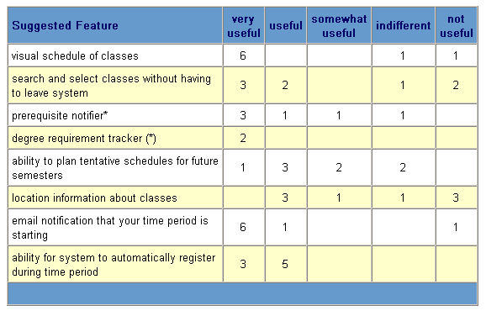
Analysis of user data

Slide 26
Deriving a user experience model

Slide 27
What is a scenario
Scenarios are stories about examples of use of
your site or application
They focus on user’s “stories”
What they want to do
Why
What they expect

Slide 28
Example Scenario
Persona – Jim Duncan, Software Engineer (and business Traveler)
Jim wants to plan a trip from Chicago to Los Angeles to see family. He’s got four to five
days free but should be back to work by Tuesday at the latest. Since he’s paying for it,
he wants the Cheapest fare he can get. He’ll need a car, prefers Hertz since he has
Gold Service with his Company, but he is staying with friends and family, so no hotel is
needed.
He has frequent flyer miles with United Airlines, so would prefer to use that
carrier, but is flexible if the price is right. It’s Lunchtime and he has a meeting in 30
minutes, so he’s in a hurry. At least he’d like to look at some flight fare options and
rental car prices. If it looks great, he can do it quickly, he’ll make the reservations with
a credit card.

Slide 29
Scenarios Drive Thinking About Functions
Questions generated by the business traveler scenario
Can we support quick views of cheapest fares?
Can the user enter various dates quickly to view their options?
Should we automatically offer different date ranges around the specified dates so the user does not have to ask?
Can the user enter a preference for a specific carrier?
Is the rental car information part of the research process for fares, or a separate process?
How do we transition from research to making a reservation?

Slide 30
Moving from scenarios to tasks
Scenarios can be broken down into tasks
Tasks cover the entire range of functionality
A task consists of the steps to accomplish a goal

Slide 31
Task flow design
Task 3a
Tasks
Task 1
Task 2
Task 2
Task 3a
Steps
Step 1
Step 2
Step 3
Step 4
Screens
Screen 1
Screen 2
Screen 3

Slide 32
Primary Noun Architecture
Primary Nouns
Views
Actions
Primary Noun table

Slide 33
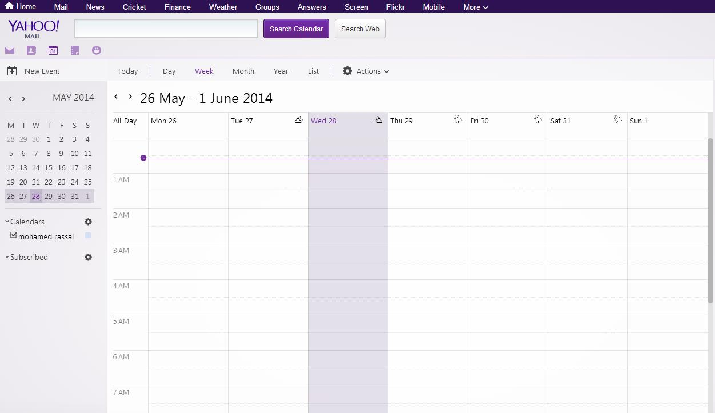
Primary nouns
Primary nouns (things I can interact with)

Slide 34
Views
6 different views of the calendar

Slide 35
Actions
Actions that can be taken on primary noun

Slide 36
Primary Noun table
Primary Noun | Count | Views | Actions | Attributes
Messages | Hundreds | List Detail | New Open Delete | From To Date Time Content
Calendar Events | One | Day Week Month | New Open Delete | Title Date Time Reminder
Contacts | Hundreds | List Detail | New Open Delete | Name Company Address Email

Slide 37
Information Architecture
What is information architecture
Different organization for different content.

Slide 38
What is Information architecture
The combination of organization, labelling and navigation schemes
A good IA helps uses to easily find products, information and functions.

Slide 39
Different Organization for Different content
Alphabetical
Chronological
Geographical
Sequence of tasks

Slide 40
Getting ready for detailed design

Slide 41
Review of the process
Define your goals (Design strategy)
Identify and describe your users (Profiles and Personas)
Learn about your users (Data Gathering)
Document what you have learned about your users (Updated Personas and Scenarios)
Create task flows
Create conceptual navigation structure and information architecture

Slide 42
Concept sketches as a part of user research
You can present it to users before the actual design
You can share it with stakeholders as well

Slide 43
Setting Usability Criteria
Learning/training:
How long should it take the user to learn the interface?
Efficiency:
How well should the interface perform?
Memorability:
How hard is it to get back up to speed after time away?
Error reduction:
Does the interface minimize error likelihood, particularly for critical errors?
Satisfaction
Is the interface clear? Fun to use? Easy?

Slide 44
Thank You

